Slide 1
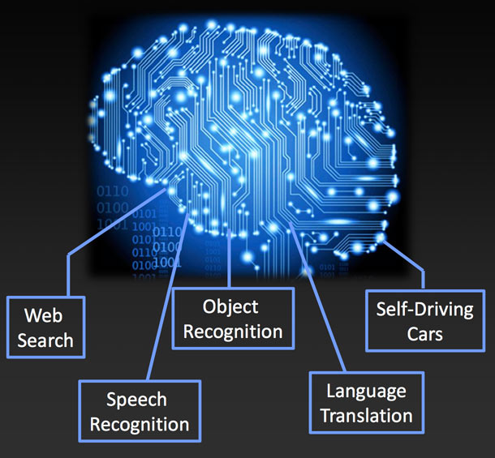
History of Neural Networks and Applications of Historical Convolutional Architectures
By Eugene Huang

Slide 2
Agenda
Part I: History of Neural Networks
Cybernetics (1940-1960s)
Connectionism (1980-1990s)
Deep Learning (2006 – Present)
Part II: Application of Convolutional Architectures
LeNet (1998)
AlexNet (2012)
VGG16 (2014)

Slide 3
Part I: History of Neural Networks

Slide 4
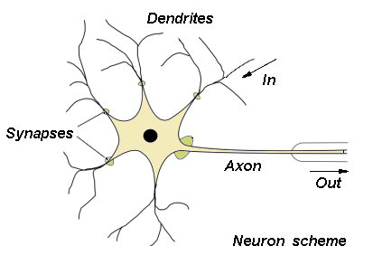
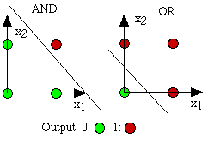
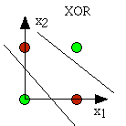
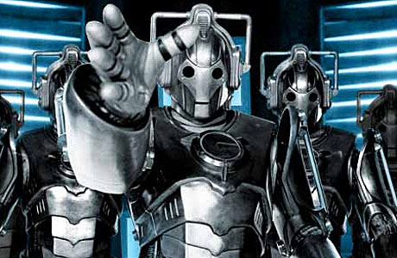
Cybernetics: 1940s-1960s
1943
McCulloch-Pitts neuron: summation over weighted inputs and step activation function
1958
Mark I Perception by Rosenblatt: included training method to determine optimal weights
1969
Minsky publishes “Perceptrons” book, showing limitations about linear separability—notably inability to create XOR
1st AI Winter: Thanks a lot, Minsky!

Slide 5
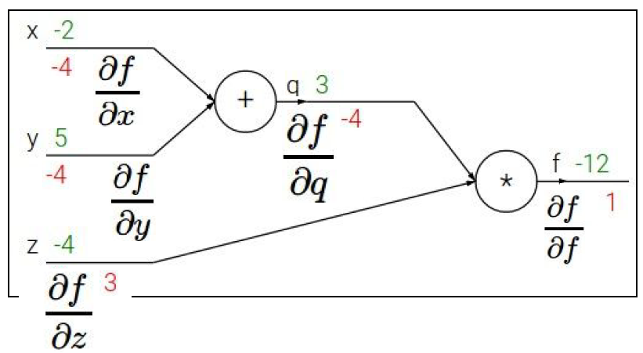
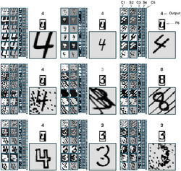
Connectionism: 1980s-1990s
1986
Hinton et al publishes “Learning Internal Representations by Error Propagation”, essentially popularizes backprop, neural nets are trainable
1989
“Multilayer Feedforward Networks are Universal Approximators”: with 1 hidden layer, you can do anything!`
1989
LeCunn publishes “Backpropagation Applied to Handwritten Zip Code Recognition”: invents convolutional layer and pooling
1989
Precursor to RNN: Waibel et al creates Time-Delay neural networks that take in ordered data
Fun Fact: Geoff Hinton = Great-great-grandson of George Boole
Poor attempt at Chuck Norris joke: Spock, want logic? Go ask Hinton—he was born from it!

Slide 6
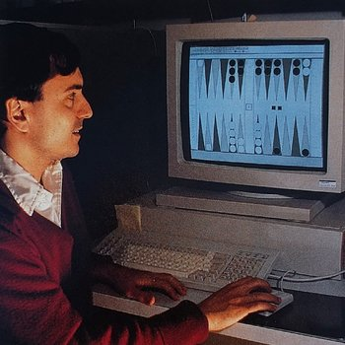
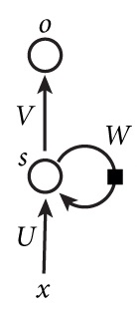
Connectionism: 1980s-1990s (cont’d)
1992
Reinforcement Learning: TD-Gammon: world class Backgammon AI
1995
Sebastian Thrun: “Learning to Play the Game of Chess” published, though not competitive with other AI
1997
Schmidhuber creates LSTM to viably train RNN for long memory, alleviates exploding/vanishing gradient problem
1998
Yann LeCun develops LeNet--convnet for reading checks
2nd AI Winter: SVMs

Slide 7
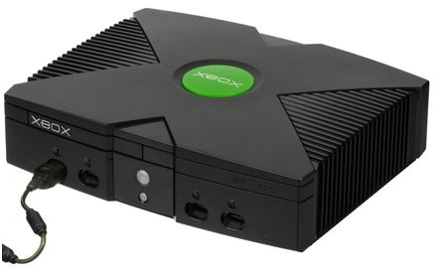

Deep Learning: 2006 -Present
2006
2009
Andrew Ng publishes “Large Scale Deep Unsupervised Learning Using Graphics Processors”, use GPUs
2010
“Understanding the Difficulty of Training Deep Feedforward Neural Networks”, develop ReLu and Xavier initialization
2012
“Deep Neural Networks for Acoustic Modeling in Speech Recognition: The Shared Views of Four Research Groups”
2012
“Improving Neural Networks By Prevent Co-Adaption of Feature Detectors”, develop Dropout
2012
“ImageNet Classification with Deep Convolutional Neural Networks”, AlexNet created and significantly outperforms SVMs
Hinton introduced unsupervised pretraining and deep belief nets, showed nets with many layers can be trained well
3nd AI Winter: NEVER!

Slide 8
Part II: Application of Convolutional Architectures

Slide 9
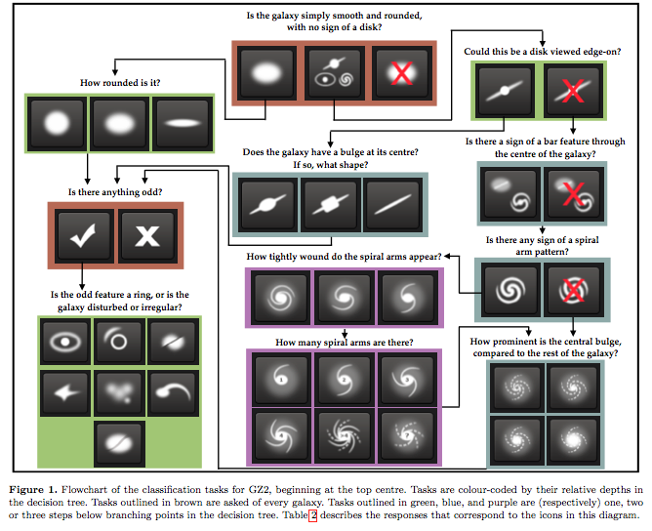
Kaggle’s Galaxy Zoo
Classify the morphologies of distant galaxies in our Universe
https://www.kaggle.com/c/galaxy-zoo-the-galaxy-challenge
Is the galaxy:
Smooth (~43%)
Features or disk (~57%)
Star or artifact? (<0.1%)
Really a binary classification problem due to imbalanced classes

Slide 10
LeNet (1998)
LeNet Upgraded
Convolution (6 filters x 5 x 5)
Input (1 channel x 32 x 32)
Pool (2 x 2)
Convolution (16 filters x 5 x 5)
Pool (2 x 2)
Dense (120 neurons)
Dense 84 neurons)
Dense (Softmax into 10)
Convolution (32 filters x 5 x 5 with stride 3)
Input (3 channel x 224 x 224)
MaxPool (2 x 2)
Convolution (256 filters x 5 x 5 with stride 3)
MaxPool (2 x 2)
Dense (64 neurons)
BatchNorm
Dense (Softmax into 3)
BatchNorm
BatchNorm
Dense (640 neurons)
BatchNorm
Sigmoid Activation
Not sure if maxpool
ReLu Activation
More filters/neurons for feature extraction from larger image
“Downsampling” in convolution
Added BatchNorm
“Gradient-Based Learning Applied to Document Recognition” by Yann LeCun, Yoshua Bengio, et al

Slide 11
AlexNet (2012)
AlexNet Upgraded
Convolution (96 filters x 11 x 11, stride 4)
Input (3 channel x 227 x 227)
MaxPool (3 x 3 with stride 2)
Convolution (256 filters x 5 x 5)
MaxPool (3 x 3 with stride 2)
Convolution (384 filters x 3 x 3)
Dense (4096 neurons)
Convolution (384 filters x 3 x 3)
Convolution (256 filters x 3 x 3)
MaxPool (3 x 3 with stride 2)
Dense (4096 neurons)
Dense (Softmax into 1000)
Dropout
Dropout
Convolution (96 filters x 11 x 11 with stride 4)
BatchNorm (3 channel x 224 x 224)
MaxPool (3 x 3 with stride 2 x 2)
Convolution (256 filters x 5 x 5)
MaxPool (3 x 3 stride 2)
Dense (Softmax into 3)
BatchNorm
BatchNorm
Dropout (p = 0.3)
Dense (800 neurons)
BatchNorm
Dropout (p = 0.3)
Convolution (384 filters x 3 x 3)
BatchNorm
Convolution (384 x 3 x 3)
BatchNorm
Convolution (256 filters x 3 x 3)
MaxPool (3 x 3 with stride 2)
Dropout (p = 0.5)
Dropout (0.5)
BatchNorm
Dense (50 neurons)
BatchNorm
Dropout (p = 0.5)
ReLu Activation
Still high “downsampling” in convolution, large filters
Used Dropout, not sure with what probability
Trained on ImageNet using GPUs
ReLu Activation
Added More Dropout -> Reduce Overfitting
Added BatchNorm -> Decrease Training Time
“ImageNet Classification with Deep Convolutional Neural Networks” by Geoff Hinton, Ilya Sutskever, et al

Slide 12
VGG16 (2014)
Convolution (64 filters x 3 x 3)
Input (3 channel x 224 x 224)
Convolution (128 filters x 3 x 3)
Convolution (128 filters x 3 x 3)
MaxPool (2 x 2)
Convolution (64 filters x 3 x 3)
MaxPool (2 x 2)
Convolution (512 filters x 3 x 3)
Convolution(512 filters x 3 x 3)
Convolution (512 filters x 3 x 3)
MaxPool (2 x 2)
Convolution (256 filters x 3 x 3)
Convolution (256 filters x 3 x 3)
Convolution (256 filters x 3 x 3)
MaxPool (2 x 2)
Dense (4096 neurons)
Dropout (p = 0.5)
Dense (4096 neurons)
Dropout (p = 0.5)
Dense (Softmax into 1000)
Convolution (512 filters x 3 x 3)
Convolution (512 filters x 3 x 3)
Convolution (512 filters x 3 x 3)
MaxPool (2 x 2)
Built from Convolutional Block and Fully Connected Block
“Very Deep Convolutional Networks for Large-Scale Image Recognition” by Karen Simonyan and Andrew Zisserman. Non-Canadians, gasp!

Slide 13
VGG16 Upgraded
Convolution (64 filters x 3 x 3)
Input (3 channel x 224 x 224)
Convolution (128 filters x 3 x 3)
Convolution (128 filters x 3 x 3)
MaxPool (2 x 2)
Convolution (64 filters x 3 x 3)
MaxPool (2 x 2)
Convolution (512 filters x 3 x 3)
Convolution(512 filters x 3 x 3)
Convolution (512 filters x 3 x 3)
MaxPool (2 x 2)
Convolution (256 filters x 3 x 3)
Convolution (256 filters x 3 x 3)
Convolution (256 filters x 3 x 3)
MaxPool (2 x 2)
Dense (4096 neurons)
BatchNorm
Dropout (p = 0.5)
Dense (4096 neurons)
BatchNorm
Dropout (p = 0.5)
Dense (Softmax into 3)
Convolution (512 filters x 3 x 3)
Convolution (512 filters x 3 x 3)
Convolution (512 filters x 3 x 3)
MaxPool (2 x 2)
Added BatchNorm
Added Data Augmentation
Used Pre-trained weights
Split convolution and dense layers into separate layers for faster training time

Slide 14
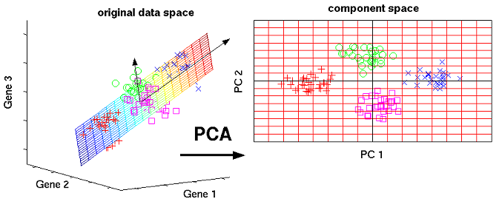
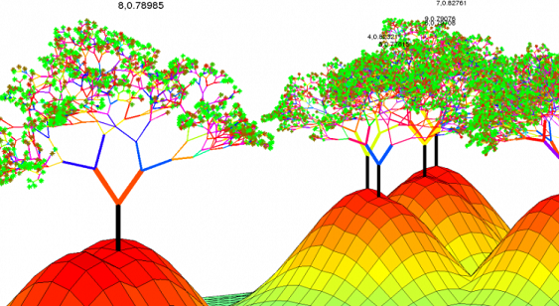
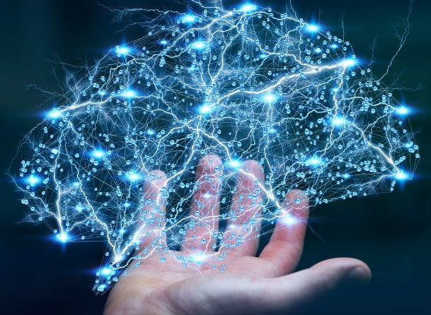
One More Thing… Random Forest
PCA
Incremental PCA
Random Forest
GridSearched over RF hyperparameters
Used Stratified K-Fold Cross-Validation
Iterative Method for RAM efficiency
224 * 224 * 3 = 150,528 dimensions => 100 components
Neural Net
Input
Dropout + BatchNorm
Dense
Dropout + BatchNorm
Dense (Softmax)

Slide 15
Lessons Learned | Interesting Thoughts
Don’t be a Hero! Use a pre-trained net
PCA + RF are actually very good
Neural nets are powerful but are still a manual process
Linear Algebra for forward pass, calculus for backpropagation
Convolutions take time; Dense layers take RAM
Neural net = Infinitely flexible function + All-purpose parameter fitting (Backprop) + Fast and scalable (GPU)
Nets don’t really mimic the brain; Brains don’t do backprop
Though CapsuleNet actually have a biological inspiration
Never count the Canadians out!
Old architectures weren’t bad, just hardware wasn’t good (enough)
Thank You!

